Slide 1
GPS Detection
Wireless project

Slide 2
What is GPS ?
GPS, or Global Positioning System, is a satellite-based navigation system that allows users to determine their exact location (latitude and longitude) anywhere on Earth. It uses signals from a network of satellites to provide accurate location information and time.

Slide 3
Key Features of GPS
Global Coverage: Provides location data anywhere on Earth
Real-Time Navigation: Offers live tracking and route guidance.
High Accuracy: Can determine location within a few meters.
Time Synchronization: Provides precise time information.
Multiple Applications: Used in navigation, mapping, tracking.
User-Friendly: Accessible via various devices, including smartphones and dedicated GPS units.
3D Positioning: Determines latitude, longitude, and altitude.
Wide Accessibility: Available for civilian and military use.
Wide Accessibility: Available for civilian and military use.

Slide 4
Tool Used in GPS Detection
RTK (Real-Time Kinematic) is a satellite navigation technique that provides
high-precision positioning using GPS or GNSS (Global Navigation Satellite System).
Integrating RTK with GNS3 (Graphical Network Simulator-3) can help simulate and
analyze network scenarios involving RTK data
Accuracy: RTK provides centimeter-level accuracy, so ensure your setup
simulates realistic conditions.
Network Configuration: Properly configure network settings (IP addresses,
routing) to facilitate communication between devices.
Software: Use suitable RTK software that can simulate both base and rover operations.

Slide 5
Steps involved
Connect the SDR
Open rtk navigator go to input streams select TCP client in type and TCM3 in format
then in TCP client option give address as localhost and port 9999
Open GNS3 application select required satellite’s and check the port numbers and
frequency
Click on start button now each one of the satellite will open a terminal
Go back to rtk we can see some information related to this satellites
Click the start button now it will start to track some satellites
Then click on the plot button we will get the graph

Slide 6
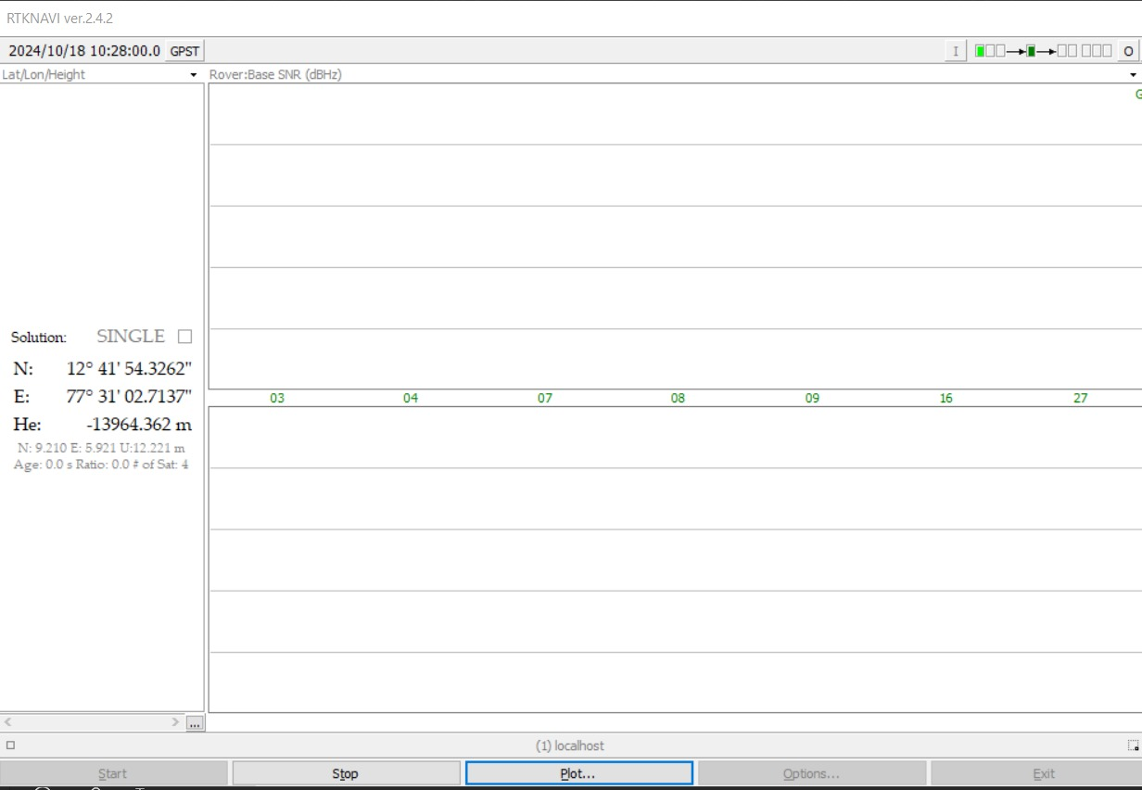
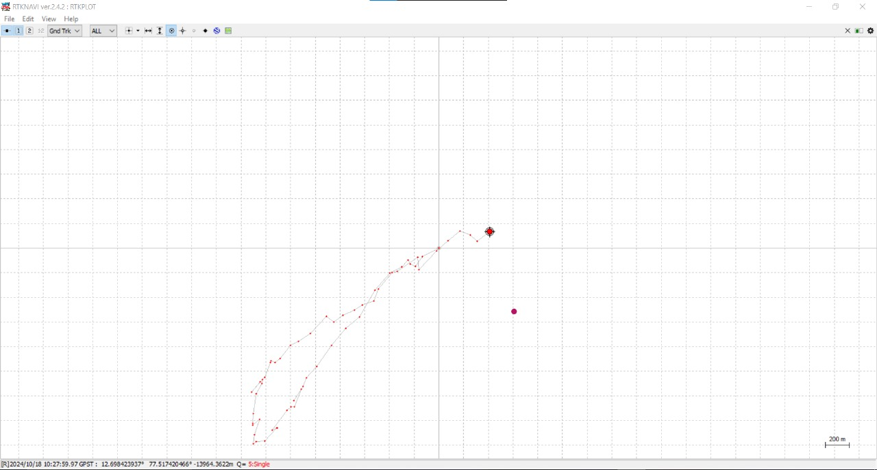
Outputs

Slide 7
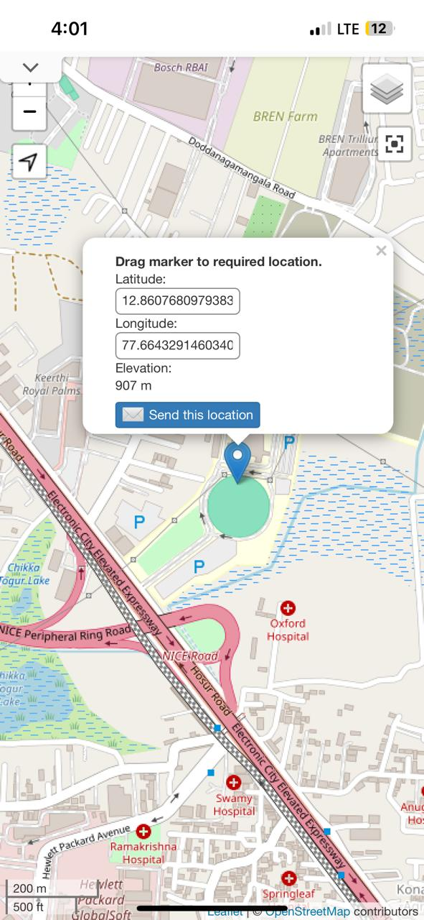
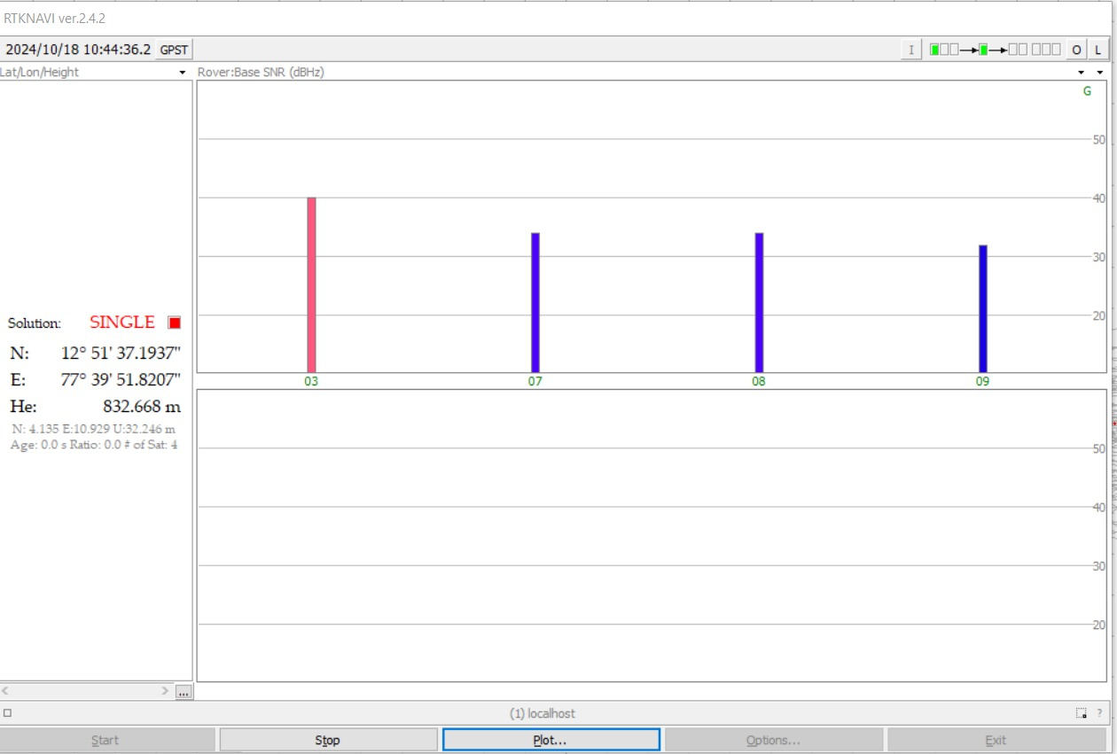

Slide 8
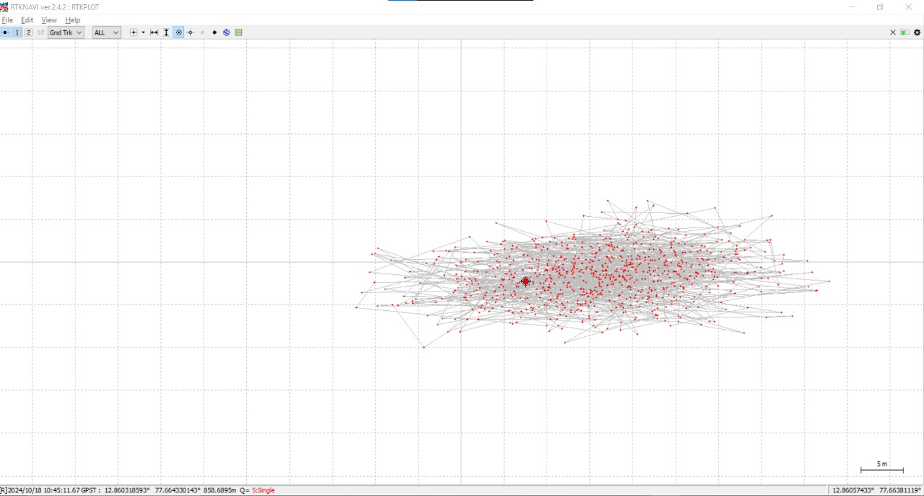

Slide 9
Thank you

